Slide 1
Defect/Bugs in Testing
Software Quality Assurance

Slide 2
What is a Defect in testing?
A defect is a system error that doesn’t allow the intended action to be completed. Finding defects is the tester’s most important task. It’s important to start testing as early as possible because defects can be found throughout the entire software development process. The earlier we identify them, the lower the costs of their fixing. All bugs should be recorded and tracked so that they can be properly managed and resolved.
A defect is an error or a bug.

Slide 3
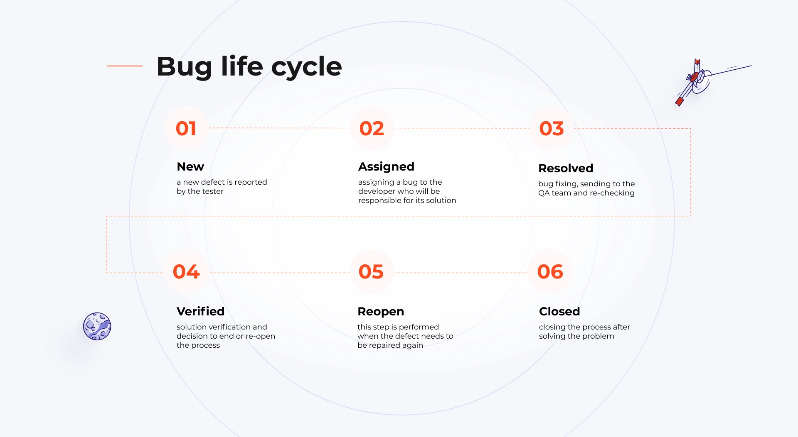
Bug Life cycle

Slide 4
Defect Report in Software Testing
A Defect Report in Software Testing is a detailed document about bugs found in a software application.
While reporting the defect/bug to a developer, your Bug Report should contain the following information:
Defect_ID – Unique identification number for the defect.
Defect Description – Detailed description of the Defect including information about the module in which the Defect was found.
Version – Version of the application in which the defect was found.
Steps – Detailed steps along with screenshots with which the developer can reproduce the defects.
Date Raised – Date when the defect is raised
Reference– where you Provide reference to the documents like. requirements, design, architecture or maybe even screenshots of the error to help understand the defect
Detected By – Name/ID of the tester who raised the defect
Status – Status of the defect, more on this later
Fixed by – Name/ID of the developer who fixed it
Date Closed – Date when the defect is closed
Severity which describes the impact of the defect on the application
The priority which is related to defect fixing urgency. Severity Priority could be High/Medium/Low based on
the impact urgency at which the defect should be fixed respectively

Slide 5
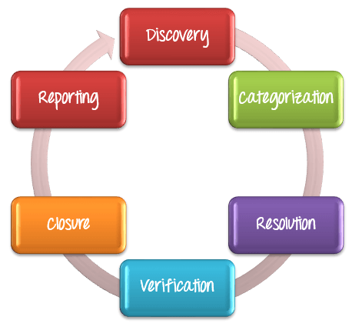
Defect Management Process:

Slide 6
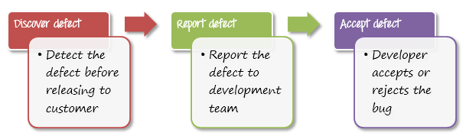
Discovery
In the discovery phase, the project teams have to discover as many defects as possible, before the end customer can discover them. A defect is said to be discovered and changed to status accepted when it is acknowledged and accepted by the developers

Slide 7
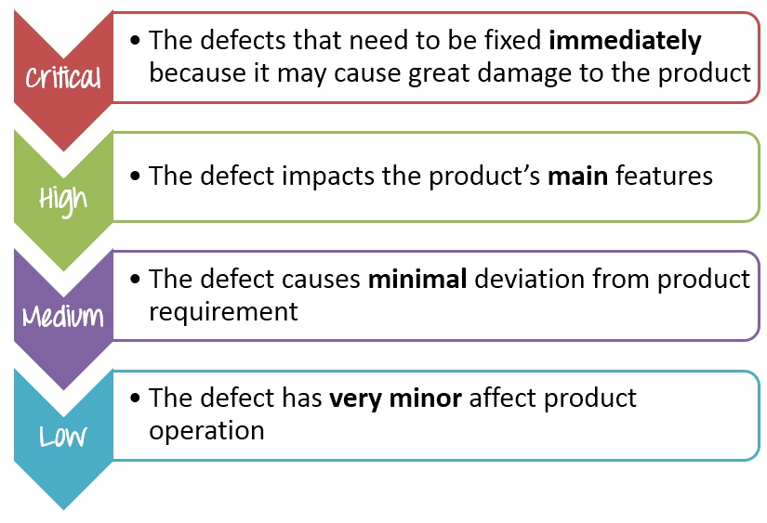
Categorization
Defect categorization helps the software developers to prioritize their tasks. That means that this kind of priority helps the developers in fixing those defects first that are highly crucial.

Slide 8
Categorization
Here are the recommended answers
No. | Description | Priority | Explanation
1 | The website performance is too slow | High | The performance bug can cause huge inconvenience to user.
2 | The login function of the website does not work properly | Critical | Login is one of the main function of the banking website if this feature does not work, it is serious bugs
3 | The GUI of the website does not display correctly on mobile devices | Medium | The defect affects the user who use Smartphone to view the website.
4 | The website could not remember the user login session | High | This is a serious issue since the user will be able to login but not be able to perform any further transactions
5 | Some links doesn’t work | Low | This is an easy fix for development guys and the user can still access the site without these links

Slide 9
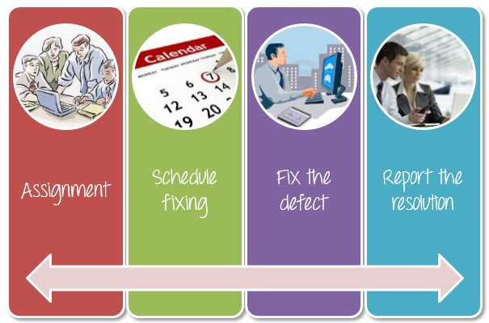
Defect Resolution
follow the following steps to fix the defect:
Assignment: Assigned to a developer or other technician to fix, and changed the status to Responding.
Schedule fixing: The developer side takes charge in this phase. Depending on the defect priority, they will create a schedule to fix these defects.
Fix the defect: While the development team is fixing the defects, the Test Manager tracks the process of fixing defects compare to the above schedule.
Report the resolution: Get a report of the resolution from developers when defects are fixed.

Slide 10
Verification
After the development team fixed and reported the defect, the testing team verifies that the defects are actually resolved.
For example, in the above scenario, when the development team reported that they already fixed 61 defects, your team would test again to verify whether these defects were actually fixed or not.
Closure
Once a defect has been resolved and verified, the defect is changed status to closed. If not, you have sent a notice to the development to check the defect again.

Slide 11
Conclusion
Software test management: the most important:
The topic of defects is very important in the context of the software development process. Bugs affect product quality, so you need to manage them properly and eliminate the most serious issues on a regular basis – all the while maintaining the continuity of other work. As far as there is no software without bugs, it is hard to keep the company safe from the above-mentioned outcomes. Trying to mitigate business risks pay more attention to proper QA and testing of your software.

